Slide 1

REPORT FILE

Slide 2
INDEX
INTRODUCTION
COMPLETE CODE
MY WEBSITE
HOW IT WORKS
PRIVACY POLICY
ACKNOWLEDGEMENT
THANK YOU

Slide 3
INTRODUCTION
NAME – PRABHAKAR
COURSE – BCA
SECTION – B
ROLL NO – 229230
SUBJECT –Technical training
SUBMITTED TO – GARVIT VERMA

Slide 4
MY WEBSITE CODE
<!DOCTYPE html>
<html lang="en">
<head>
<meta charset="UTF-8">
<meta http-equiv="X-UA-Compatible" content="IE=edge">
<meta name="viewport" content="width=
, initial-scale=1.0">
<title>GOGETA Store</title>
<style>
.nav {
position: sticky;
background-color: rgba(238, 255, 0, 0.541);
padding: 20px;
text-decoration: none;
top: 0;
border: 5px solid blue;
width: 1461px;
word-spacing: 70px;
}
ul li a:hover {
background-color: aqua;
color: black;
transition: 0.6s ease
}
ul,
li {
display: inline;
}

Slide 5
MY WEBSITE CODE
li {
color: rgb(253, 253, 253);
float: left;
display: inline;
}
a {
text-decoration: none;
color: whitesmoke;
}
a:hover{
text-decoration: underline;
color: white;
color: whitesmoke;
}
.column {
float: right;
}
.img1 {
position: relative;
left: 15px;
}
div>img:hover {
transform: scale(1.1);

Slide 6
MY WEBSITE CODE
.img2 {
/* float:left; */
position: absolute;
left: 29px;
}
div>img:hover {
animation-name: self;
animation-duration: 2s;
animation-timing-function: ease-in-out;
transform: scale(1.1);
}
.img4 {
float: left;
}
.img3 {
float: left;
}
.img5 {
float: right;
}
body {
background-image: linear-gradient(60deg, rgb(165, 27, 110), rgb(106, 27, 113), rgb(8, 103, 84));
}

Slide 7
MY WEBSITE CODE
button {
border-radius: 2px;
background-color: rgb(222, 236, 70);
text-decoration-color: black;
size: 25px;
}
.images {
display: flex;
flex-direction: row;
}
.para {
padding-left: 100px;
}
.para1{
padding-left: 530px;
padding-top: 0px;
}
h3{
color: rgb(30, 166, 121);
font-size: 45px;
padding-left:90px;
font-style:italic;
} h4{padding-left: 1250px;
font-size: xx-large;
}
</style>
</head>

Slide 8
MY WEBSITE CODE
<body>
<div class="nav">
<img src="https://play-lh.googleusercontent.com/XCdNhduGkQeEET0kmAvCo9kCFRZhdmVtZ4doAO9kGzfmxV85gF_5j4phzedxc1lhvYc=w240-h480-rw"
height="60px" width="80px">
<a href="">HOME</a>
<a href="">STORE</a>
<a href="">SUPPORT</a>
<a href="">FAQ</a>
<select>
<option>SOFTWARE</option>
<option>PC GAMES</option>
<option>ANDRIOD GAMES</option>
<option>IOS GAMES</option>
<option>ONLINE GAMES</option>
</select>
<input type="search" placeholder="search store games"><button>search</button>
<a href="file:///D:/vs%20code/login%20page.html">LOGIN</a>
<button>DOWNLOAD</button>
</div>

Slide 9
MY WEBSITE CODE
<div class="name"><h3>PC Games</h3></div>
<div class="photos">
&nbsp;&nbsp;&nbsp;&nbsp;&nbsp;&nbsp;&nbsp;&nbsp;&nbsp;&nbsp;
<img src="https://img.republicworld.com/republic-prod/stories/promolarge/xhdpi/sckreoimuvgbv7go_1639154140.jpeg" width="450px" height="350px">&nbsp;&nbsp;&nbsp;&nbsp;&nbsp;&nbsp;&nbsp;&nbsp;
<img src="https://imgs.callofduty.com/content/dam/atvi/callofduty/cod-touchui/mw2/meta-images/reveal/mw2-reveal-meta-share.jpg" width="450px" height="350px">&nbsp;&nbsp;&nbsp;&nbsp;&nbsp;&nbsp;&nbsp;&nbsp;
<img src="https://images.contentstack.io/v3/assets/bltb6530b271fddd0b1/blt1d72b5b9518e767b/6348b9a2b3f39b38fccfbac4/VALORANT_2022_E5-3_PlayVALORANT_ContentStackThumbnail_1200x625_MB01_opt.jpg" width="450px" height="350px"><br><br><br><br>
&nbsp;&nbsp;&nbsp;&nbsp;&nbsp;&nbsp;&nbsp;&nbsp;&nbsp;&nbsp;&nbsp;
<img src="https://s3.us-east-1.amazonaws.com/nd.images/uploads/960x540_U4_PSX.jpg" width="450px" height="350px">&nbsp;&nbsp;&nbsp;&nbsp;&nbsp;&nbsp;&nbsp;&nbsp;&nbsp;
<img src="https://www.unpause.asia/wp-content/uploads/God-of-War-Ragnarok-PlayStation-5-PS5-PS4-Sony-Kratos-Atreus-Norse-Gods-1240x775.jpg" width="450px" height="350px">&nbsp;&nbsp;&nbsp;&nbsp;&nbsp;&nbsp;&nbsp;&nbsp;&nbsp;&nbsp;&nbsp;&nbsp;&nbsp;&nbsp;&nbsp;&nbsp;&nbsp;&nbsp;&nbsp;
<img src="https://media-rockstargames-com.akamaized.net/rockstargames-newsite/img/global/games/fob/1280/V.jpg" width="300px" height="350px">
<h4><i><a href="file:///F:/vs%20code/pc-games.html">More....</a></i></h4>
</div>

Slide 10
MY WEBSITE CODE
<div class="name"><h3>Andriod Games</h3></div>
<div class="andriodgamesphotos">
&nbsp;&nbsp;&nbsp;&nbsp;&nbsp;&nbsp;&nbsp;&nbsp;&nbsp;&nbsp;&nbsp;&nbsp;
<img src="https://assets1.ignimgs.com/2019/02/04/apex-legends---button-fin-1549319070496.jpg" width="450px" height="350px">&nbsp;&nbsp;&nbsp;&nbsp;&nbsp;&nbsp;&nbsp;&nbsp;&nbsp;
<img src="https://cdn1.epicgames.com/salesEvent/salesEvent/EGS_GenshinImpact_miHoYoLimited_S1_2560x1440-91c6cd7312cc2647c3ebccca10f30399" width="450px" height="350px">&nbsp;&nbsp;&nbsp;&nbsp;&nbsp;&nbsp;&nbsp;
<img src="https://images.ctfassets.net/vfkpgemp7ek3/2477652009/769e8b90ebf861d4d72a763fb81b54e6/pokemon-go-two-years.jpg" width="450px" height="350px"><br><br><br>
&nbsp;&nbsp;&nbsp;&nbsp;&nbsp;&nbsp;&nbsp;&nbsp;&nbsp;&nbsp;&nbsp;&nbsp;
<img src="https://m.media-amazon.com/images/I/81YlOXRdKwL.jpg" width="450px" height="350px">&nbsp;&nbsp;&nbsp;&nbsp;&nbsp;&nbsp;&nbsp;&nbsp;&nbsp;
<img src="https://www.internetmatters.org/wp-content/uploads/2020/10/Among-us-image-630.png" width="450px" height="350px">&nbsp;&nbsp;&nbsp;&nbsp;&nbsp;&nbsp;&nbsp;&nbsp;
<img src="https://assets1.ignimgs.com/2018/03/06/fortnite---button-1520296499714.jpg" width="450px" height="350px">
<h4><i><a href="">More....</a></i></h4>
</div>

Slide 11
MY WEBSITE CODE
<div class="name"><h3>Driver</h3></div>
<div class="driverphotos">
&nbsp;&nbsp;&nbsp;&nbsp;&nbsp;&nbsp;&nbsp;&nbsp;&nbsp;&nbsp;&nbsp;&nbsp;
<img src="https://developer.nvidia.com/sites/default/files/akamai/gamedev/DirectX-Image.png" width="550px" height="450px">&nbsp;&nbsp;&nbsp;&nbsp;&nbsp;&nbsp;&nbsp;&nbsp;&nbsp;&nbsp;&nbsp;&nbsp;&nbsp;
<img src="https://yt3.ggpht.com/JKNyU1hUatihvPGtWUAW3NLEzCjOB8P5G8PY6JUKyoohNRha-gklOVXVzA1vDKidrIiJCOgtCA=s900-c-k-c0x00ffffff-no-rj" width="550px" height="450px">
<h4><i><a href="">More....</a></i></h4>
</div>
<div class="name"><h3>Emulator Software</h3></div>
<div class="emulator">
&nbsp;&nbsp;&nbsp;&nbsp;&nbsp;&nbsp;&nbsp;&nbsp;&nbsp;&nbsp;&nbsp;&nbsp;
<img src="https://yt3.ggpht.com/ytc/AMLnZu_CSOuwi6Qy8mh3B46jZ1WpwftrgYt14rpgD6tv=s900-c-k-c0x00ffffff-no-rj" width="550px" height="450px">&nbsp;&nbsp;&nbsp;&nbsp;&nbsp;&nbsp;&nbsp;&nbsp;&nbsp;&nbsp;&nbsp;&nbsp;&nbsp;
<img src="https://image3.mouthshut.com/images/imagesp/925754976s.jpg" width="550px" height="450px">
<h4><i><a href="">More....</a></i></h4>
</div></body>
</html>

Slide 12
MY LOGIN PAGE CODE
<!DOCTYPE html>
<html lang="en">
<head>
<meta charset="UTF-8">
<meta http-equiv="X-UA-Compatible" content="IE=edge">
<meta name="viewport" content="width=device-width, initial-scale=1.0">
<title>Document</title>
<style>
#{ padding: 0;
margin: 0;
font-family: sans-serif;}
body{background-image: url(https://dlcdnrog.asus.com/rog/media/1584049084712.webp);
background-repeat: repeat;
height: 550px;
width: 490px;
font-family: sans-serif;
}
.login{
width: 320px;
height: 420px;
top: 50%;
left: 50%;
transform:translate(-50%,-50%);
position: absolute;
box-sizing: border-box;
border: 2000px;
}
.p{
text-decoration: white;
}
</style>
</head>

Slide 13
MY LOGIN PAGE CODE
<body dir="body">
<div class="login">
<hr>
<div class="box">
<h1>Log in</h1>
<form action="#" method="post">
<p>user name</p>
<input type="text" name="user" placeholder="User name">
<p>password</p>
<input type="text" name="password" placeholder="password"><br><br>&nbsp;&nbsp;&nbsp;&nbsp;&nbsp;&nbsp;&nbsp;&nbsp;&nbsp;&nbsp;&nbsp;&nbsp;
<button>Submit</button>
</form>
</div>
</div>
</body>
</html>

Slide 14
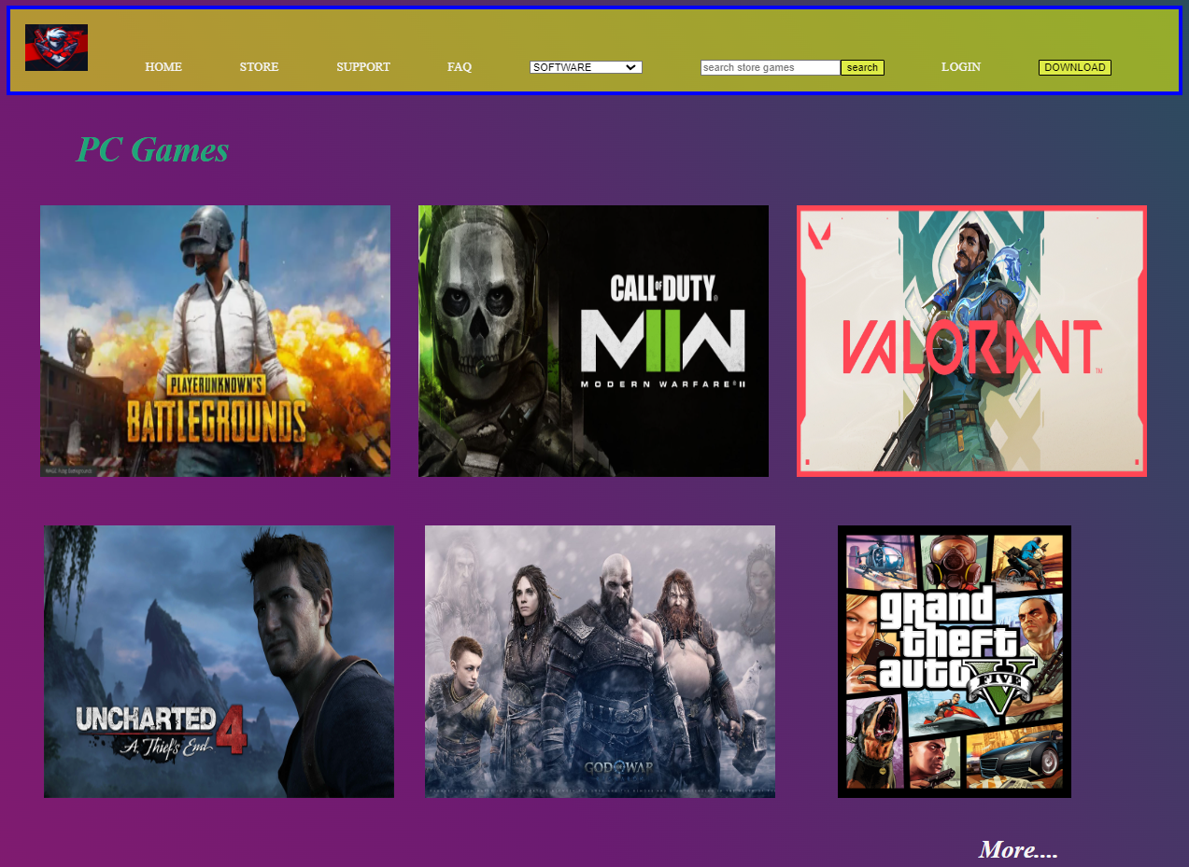
THE LOOKS OF MY WEBPAGE

Slide 15
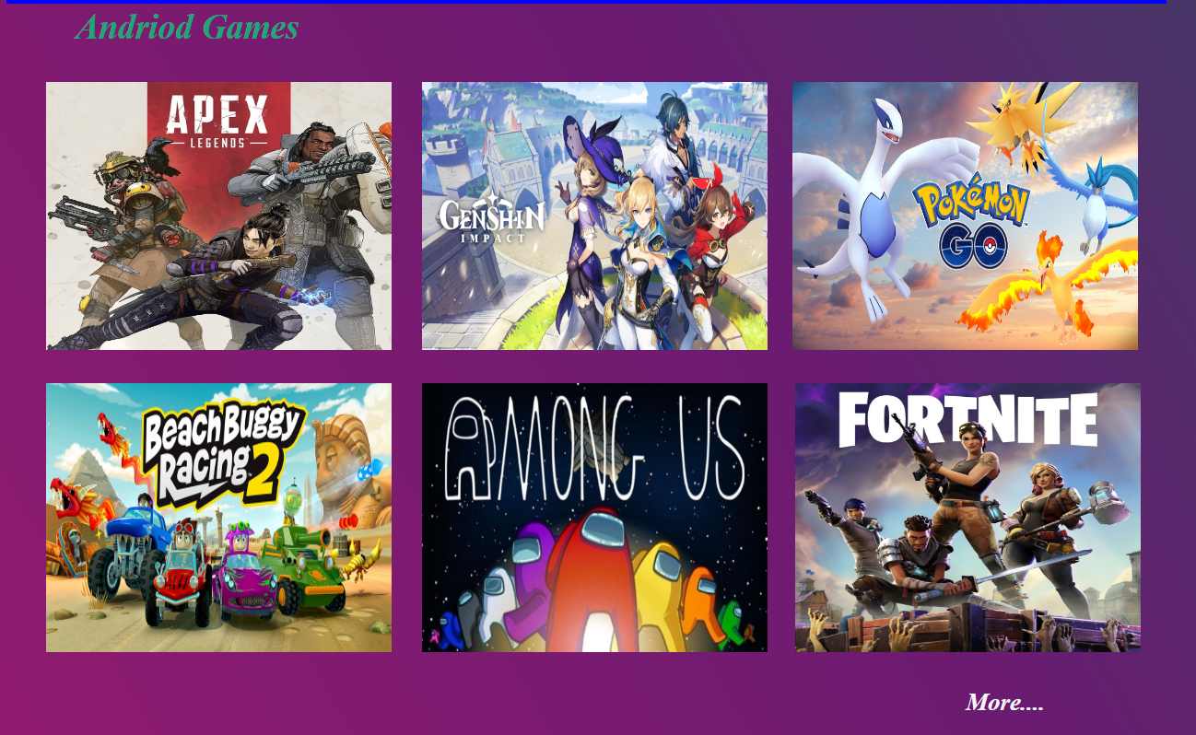
THE LOOKS OF MY WEBPAGE

Slide 16

THE LOOK OF MY WEBPAGE

Slide 17

THE LOOK OF MY WEBPAGE

Slide 18
HOW IT WORKS
This website is made for downloading different types of games.
It consist of :- PC games , Android games , ios games ,
Game driver , Emulator software

Slide 19
HOW IT WORKS
It is made for high speed downloading
of games.
This website is the associated partner of the _ _ _ _ _ app store.

Slide 20
Privacy policy
We build privacy tools that put you in control. Protecting your privacy starts with the world's most advanced security.
Five elite security teams. Six never-before-told stories. Go behind the scenes with the hackers protecting more people online than anyone else in the world.

Slide 21
ACKNOWLEDGEMENT
It is a great relief and satisfaction whenever we accomplish a college project. Whenever a project was completed then there will definitely be the support and guidance of our teachers, principal, friends, and family members. So it is always a good practice to acknowledge all the members who supported in completing your project.
Here You can find some sample acknowledgment copies which you can use in acknowledging your college projects, group projects, and assignments.

Slide 22


